Slide 1
Control and Loop Structures
By: Iman Khani Jazani
Senior Data Scientist, Community builder | Adin
AI and Data Specialist, Business Developer | AiHum
Adjunct Professor | Sharif University of Technology

Slide 2

Last Lecture
Short Presentation
Review the Last Lecture
What are statements from flowchart view?
Programming with Python
Application of Programming in the Digital Age!

Slide 3
Today
Short Presentation
Review the Last Lecture
Coding a simple example
Programming with Python
Application of Programming in the Digital Age!

Slide 4
Together
Send your feedback about the class whenever you want!

Slide 5

Contact me
Gmail: ImanKhaniJazani@gmail.com
LinkedIn: https://www.linkedin.com/in/ImanKhaniJazani/
Telegram: @IKJ1992

Slide 6
Grading
راه جبران هم تحت شرایطی وجود داره!
Approx. 25% Programming Assignments (judgment with Quera)
Approx. 14% Mid-term Project (alone, judgment with TAs and Quera)
Approx. 37% Final Project (team work~5 member, judgment with TAs and Quera)
Proposal (about real needs)
Coding
Release
Approx. 30% Final Exam (algorithm-based paper exam)
Approx. 5% Short Presentation(extra score , for the next week lecture, only for the first two person)
Approx. 2% Challenging Questions and Contributions in Class or Telegram group (extra score)
Approx. 7% long presentation (extra score)
Approx. ?% Quiz
Notes:
120 score

Slide 7
Short Presentations

Slide 8
How can computer detect which locations in memory are instruction or value or …?
Who is volunteer for the short presentation?
Reserved
Short Presenration

Slide 9
What is clean code? What is clean code in Python? How can we care it?
Who is volunteer for the short presentation?
Short Presenration

Slide 10
Review the Last Lecture

Slide 11
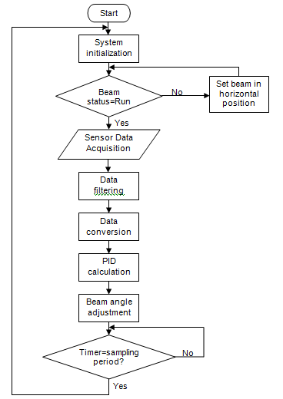
We have different types of statement!
Simple statement (+)
Loop statement (while, for)
Control statement (if, else, elif)

Slide 12
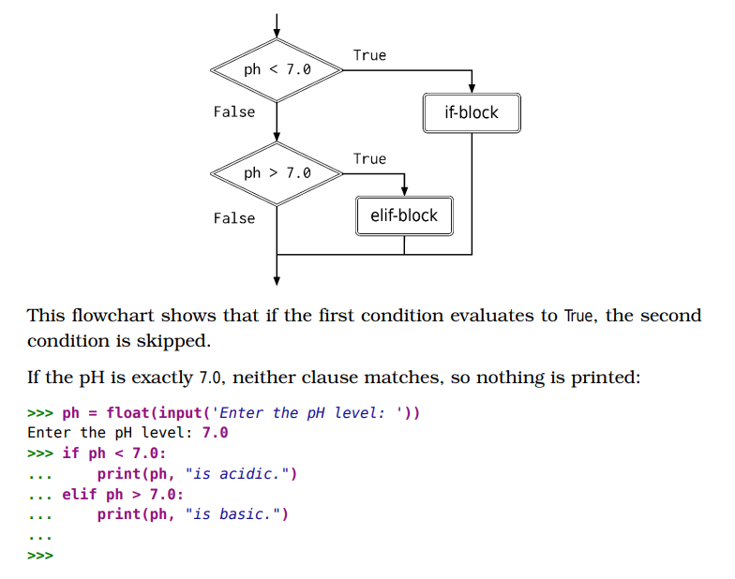
Control statements

Slide 13
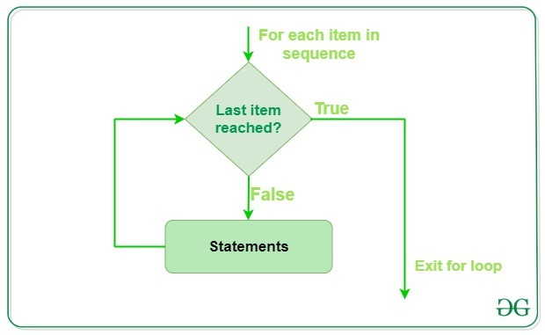
Simple example

Slide 14
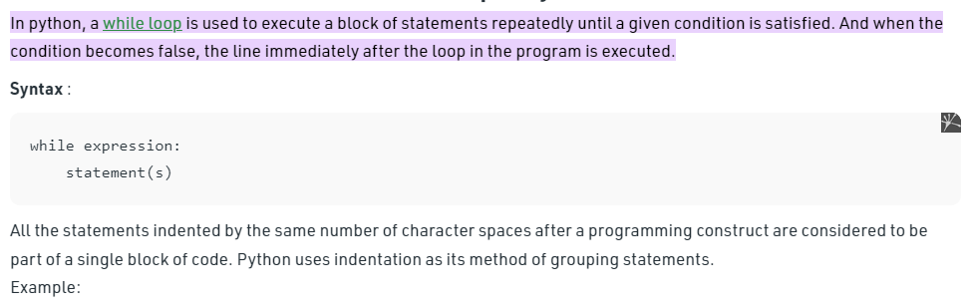
Loop statements

Slide 15
نتیجه کوئیز یهویی...
https://www.aparat.com/v/1XLFZ?playlist=457876 (مدرس: مسعود کاویانی عزیز)
https://maktabkhooneh.org/course/%D8%A2%D9%85%D9%88%D8%B2%D8%B4-%D8%B1%D8%A7%DB%8C%DA%AF%D8%A7%D9%86-%D9%BE%D8%A7%DB%8C%D8%AA%D9%88%D9%86-%D9%85%D9%82%D8%AF%D9%85%D8%A7%D8%AA%DB%8C-mk674/
https://maktabkhooneh.org/course/%D8%A2%D9%85%D9%88%D8%B2%D8%B4-%D8%A8%D8%B1%D9%86%D8%A7%D9%85%D9%87-%D9%86%D9%88%DB%8C%D8%B3%DB%8C-%D8%A8%D8%A7-%D9%BE%D8%A7%DB%8C%D8%AA%D9%88%D9%86-%D9%85%D9%82%D8%AF%D9%85%D8%A7%D8%AA%DB%8C-mk346/
https://maktabkhooneh.org/course/%D8%A2%D9%85%D9%88%D8%B2%D8%B4-%D8%B1%D8%A7%DB%8C%DA%AF%D8%A7%D9%86-%D9%BE%D8%A7%DB%8C%D8%AA%D9%88%D9%86-%DA%A9%D8%A7%D8%B1%D8%A8%D8%B1%D8%AF%DB%8C-mk1352/
یوتیوب

Slide 16
BUT, our class is based on:
BFS 🍕

Slide 17
Coding a Simple Example

Slide 18
Power of a number…
What are inputs, outputs?
What is its algorithm?
What is its flowchart?
Lets go to our coding ☺

Slide 19
For Now…
Numeric
Boolean
String
List

Slide 20
Programming with Python

Slide 21
Question
What is the website need?
How can we get more users for our news website?
Our solution: find most frequent words in news
آیا کارمون اخلاقی بود؟!؟

Slide 22
Example of news
https://www.theguardian.com/uk-news/2023/mar/05/rishi-sunaks-plan-for-small-boats-will-lock-up-people-fleeing-war

Slide 23
From question to algorithm!
Understand your needs or questions!
explain easily for someone else
Decompose your problem (make some steps)!
Make a flowchart for the decomposed version of your problem
Explain each steps in one or two sentences (paper-based or paperless)
input, output, process
Explain each steps mathematically…
Develop your algorithms for each steps
Check your process flow from the first step to the last one!

Slide 24

Let’s go for your solutions and coding with each other😉
Input?
Output?
Process?

Slide 25
Application of Programming in the Digital Age!

Slide 26
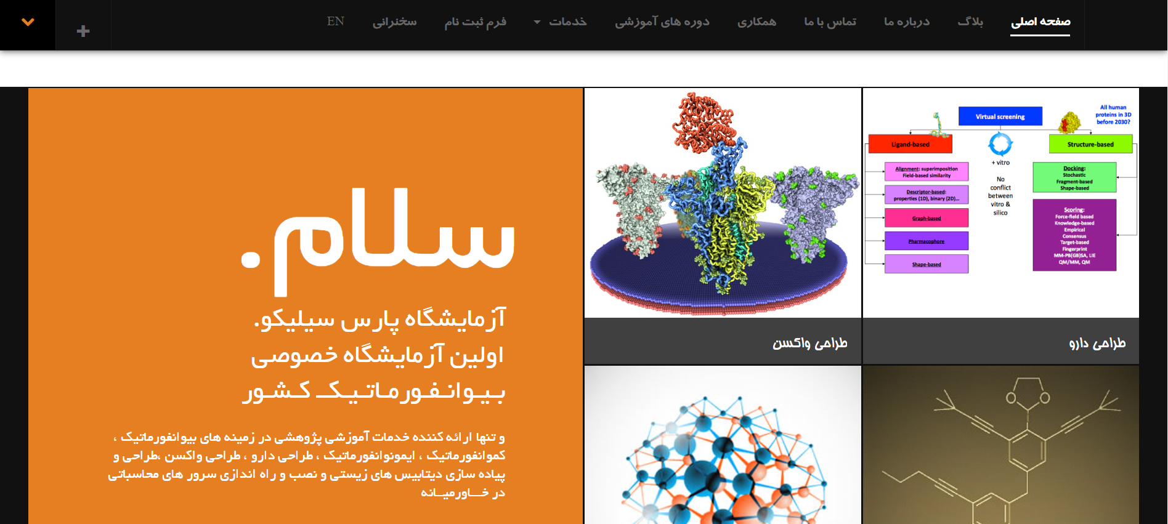
طراحی داروهای شخصی‌سازی شده!

Slide 27
ساخت موجودی شبیه به انسان ممکن است؟

Slide 28
Lecture Resources

